Slide 1
Review: Batch Reactor Basic Molar Balance
No material enters or leaves the reactor
In ideal reactor, composition and temperature are spatially uniform (i.e. perfect mixing)
No flow in or out of reactor. F_{j0} and F_{j} = 0.
Rate of generation of reactant A in reactor due to rxn
Rate of accumulation of
reactant A in reactor
=
Batch Reactor Design Equation
Ideal (perfectly mixed) reactor: spatially uniform temp, conc, & reaction rate
Ideal Batch Reactor Design Equation

Slide 2
Review: CSTR Basic Molar Balance
Continuously add reactants and remove products
In an ideal reactor, composition and temperature are spatially uniform (i.e. perfect mixing)
At steady state- no accumulation
F_{j0}
F_{j}
Accumulation = In - Out + Generation
by rxn
0 = F_{j0} - F_{j} +
No spatial variation:
Ideal Steady State CSTR Design Equation:
in terms of flow
in terms of concentration
υ (upsilon)

Slide 3
Review: Molar Balance – PFR
Flow reactor operated at steady state (no accumulation per Δ)
Composition of fluid varies down length of reactor (material balance for differential element of volume ΔV
ΔV
F_{A0}
F_{A}
F_{j0}
-
F_{j}
+
=
Ideal SS PFR Design Eq.

Slide 4
Review: Molar Balance- Packed Bed Reactor (PBR)
Heterogeneous rxn: reaction occurs at catalyst particle surface
Concentration gradient of reactant and product change down length of the reactor
Rxn rate based on the mass of catalyst W, not reactor volume V
Similar to PFR, but expressed in terms of catalyst weight instead of reactor volume
Units for the rate of a homogeneous rxn (r_{j}) :
Units for the rate of a catalytic rxn (r_{j}’) :
So in terms of catalyst weight instead of reactor volume:

Slide 5
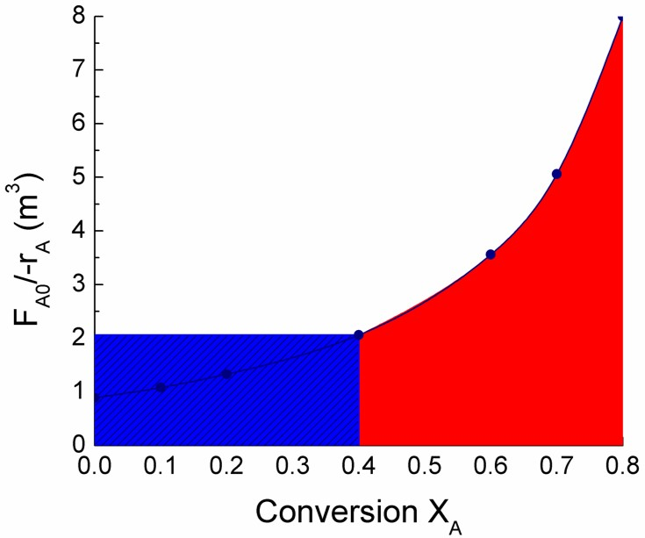
L3: Conversion and Reactors in Series
F_{A1}, X₁
F_{A1}, X₁
F_{A2}, X₂
F_{A0} X₀
F_{A0} X₀
V₂
F_{A2}
X₂
V₁
V₂
V₁
V_{CSTR1}
V_{PFR2}

Slide 6
Conversion, X_{A}
Conversion is convenient for relating: r_{j}, V, υ, N_{j}, F_{j}, and C_{j}
Choose limiting reactant A as basis of calculation and normalize:
BATCH
SYSTEM:
“Moles A fed” is the amount of A at the start of the reactor (t=0)
FLOW
SYSTEM:
“Moles A fed” is the amount of A entering the reactor
Usually pick the basis to be the limiting reagent

Slide 7
Conversion Example
A + 2B → 2C
Start with 1 mole of A & 1 mole of B
If A is the basis and at the end we have:
1 mole A, 1 mole B ↔ X_{A} = 0/1 = 0 (no reaction)
½ mole A, 0 mole B ↔ X_{A} = 0.5/1 = 1/2
0 mole A, -1 mole B ↔ X_{A} = 1/1 = 1 (complete reaction)
Not possible!
The correct approach is to take B as the basis because B is the limiting reagent
At the end we have:
1 mole A, 1 mole B ↔ X_{B} = 0/1 = 0 (no reaction)
½ mole A, 0 mole B ↔ X_{B} = 1/1 = 1 (complete reaction)

Slide 8
Expressing other Components in Terms of Conversion of A (X_{A})
Longer reactant is in reactor, more reactant is converted to product (until reactant is consumed or the reaction reaches equilibrium)
∴ Conversion (X_{j}) is a function of time (t) in the batch reactor
BATCH
SYSTEM:
Moles A in reactor at time t
Moles A fed
-
Moles A consumed
=
reactant
product

Slide 9
Expressing other Components in Terms of Conversion of A (X_{A})
Total moles in reactor at time t
Total moles fed
total moles products formed minus reactants consumed
=
+
ν_{j}≡ stoichiometric coefficient; positive for products, negative for reactants

Slide 10
Batch Reactor Design Equation with X_{j}
In terms of A:
Ideal Batch Reactor Design Eq:
Want to determine how long to leave reactants in reactor to achieve a desired value for the conversion
→ take derivative of “N_{A}” equation w/ respect to time
←Substitute into batch reactor design eq
Ideal Batch Reactor Design Eq with X_{j}:

Slide 11
Flow and Conversion
For a given flow rate, the larger the reactor, the more time it takes the reactant to pass through the reactor, the more time to react
∴ Conversion (X_{j}) is a function of reactor volume (V)
FLOW
SYSTEM:
Molar flow rate A is fed to reactor
Molar flow rate that A leaves the reactor
-
Molar rate A is consumed in reactor
=

Slide 12
CSTR Design Equation & X_{j}
Ideal SS CSTR:
Substitute for F_{A}
Ideal CSTR design eq in terms of X_{A}
V ≡ CSTR volume required to achieve a specified conversion
Note: X_{A} and –r_{A} are evaluated at the exit of the CSTR

Slide 13
PFR Design Equation & X_{j}
Ideal SS PRF:
Want to determine the reactor volume required to achieve a desired amount of conversion
→ take derivative of “F_{A}“ expression with respect to volume
←Substitute into PFR design eq
Ideal SS PFR Design Eq with X_{j}:
Applies for no pressure drop down PFR!

Slide 14
PBR Design Equation & X_{j}
Ideal SS PBF:
Want to determine the weight of catalyst that is required to achieve a desired amount of conversion
→ take derivative of F_{A} expression with respect to W
←Substitute into PBR design eq
Ideal SS PBR Design Eq with X_{j}:
Applies for no pressure drop down PBR!

Slide 15
Sizing CSTRs
We can determine the volume of the CSTR required to achieve a specific conversion if we know how the reaction rate r_{j} depends on the conversion X_{j}
Ideal SS CSTR design eq.
Volume is product of F_{A0}/-r_{A} and X_{A}
Plot F_{A0}/-r_{A} vs X_{A} (Levenspiel plot)
V_{CSTR} is the rectangle with a base of X_{A,exit} and a height of F_{A0}/-r_{A}

Slide 16
Sizing a CSTR with a Levenspiel Plot
X_{A} | 0 | 0.1 | 0.2 | 0.4 | 0.6 | 0.7 | 0.8
F_{A0}/-r_{A} | 0.89 | 1.08 | 1.33 | 2.05 | 3.56 | 5.06 | 8
V_{CSTR} for X_{A} = 0.4?
Value of F_{A0}/-r_{A} for X_{A}=0.4
V_{CSTR} for X_{A} = 0.8?

Slide 17
Sizing PFRs
We can determine the required volume of a PFR to achieve a specific conversion if we know how the reaction rate r_{j} depends on the conversion X_{j}
Ideal PFR design eq.
Plot F_{A0}/-r_{A} vs X_{A} (Experimentally determined numerical values)
V_{PFR} is the area under the curve F_{A0}/-r_{A} vs X_{A,exit}

Slide 18
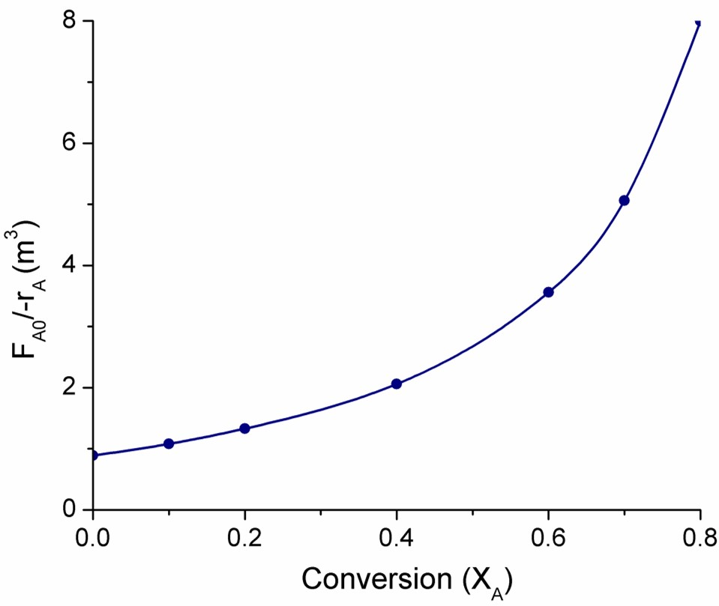
Sizing a PFR with a Levenspiel Plot
X_{A} | 0 | 0.1 | 0.2 | 0.4 | 0.6 | 0.7 | 0.8
F_{A0}/-r_{A} | 0.89 | 1.08 | 1.33 | 2.05 | 3.56 | 5.06 | 8
V_{PFR} for X_{A} = 0.4?
We do not have an expression for –r_{A}(X_{A})

Slide 19
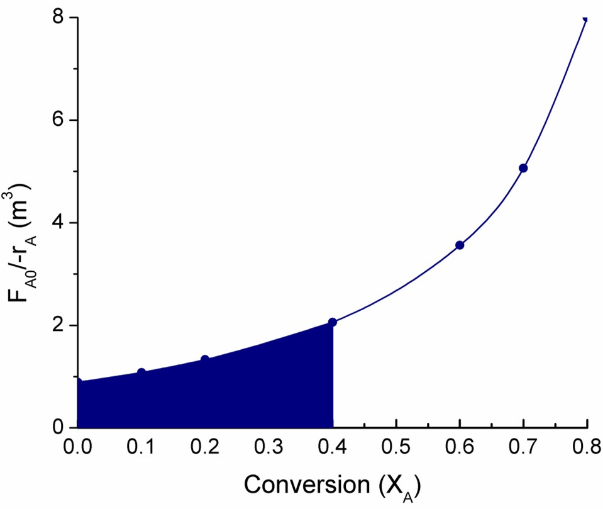
Sizing a PFR with a Levenspiel Plot
X_{A} | 0 | 0.1 | 0.2 | 0.4 | 0.6 | 0.7 | 0.8
F_{A0}/-r_{A} | 0.89 | 1.08 | 1.33 | 2.05 | 3.56 | 5.06 | 8
V_{PFR} for X_{A} = 0.4?
We do not have an expression for –r_{A}(X_{A})
Numerically evaluate (Appendix A.4) to estimate the area under the curve
Volume of PFR

Slide 20
Numerical Evaluation of Integrals (A.4)
Trapezoidal rule (2-point):
Simpson’s one-third rule (3-point):
Simpson’s three-eights rule (4-point):
Simpson’s five-point quadrature :

Slide 21
Sizing a PFR with a Levenspiel Plot
X_{A} | 0 | 0.1 | 0.2 | 0.4 | 0.6 | 0.7 | 0.8
F_{A0}/-r_{A} | 0.89 | 1.08 | 1.33 | 2.05 | 3.56 | 5.06 | 8
X_{A} | 0 | 0.1 | 0.2 | 0.4 | 0.6 | 0.7 | 0.8
F_{A0}/-r_{A} | 0.89 | 1.08 | 1.33 | 2.05 | 3.56 | 5.06 | 8
0.89
1.33
2.05
V_{PFR} for X_{A} = 0.4?
X_{A} increments must be equal
Use Simpson’s one-third rule (3-point):
= area under the curve

Slide 22
Reactors in Series
In practice, reactors are usually connected so the exit stream of one reactor is the feed stream for the next reactor
Conversion up to point i (no side streams):
F_{A1}
i=1
X₁
F_{A2}
i=2
X₂
V₂
F_{A0}
F_{A3} i=3 X₃
V₁
V₃

Slide 23
2 CSTRs in Series
F_{A1}, X₁
Materials balance reactor 1:
F_{A0} X₀
In
-
Out
Gen.
Accum.
+
=
F_{A2}
X₂
V₁
V₂
Need to express F_{A1} in terms of X₁

Slide 24
2 CSTRs in Series
Materials balance reactor 2:
F_{A1}, X₁
In
-
Out
Gen.
Accum.
+
=
F_{A0} X₀
F_{A2}
X₂
V₁
V₂
Need to express F_{A2} in terms of X₂
Materials balance reactor 1:
Value of F_{A0}/-r_{A} at X₂

Slide 25
2 CSTRs in Series
F_{A1}, X₁=0.4
X_{A} | 0 | 0.4 | 0.8
F_{A0}/-r_{A} | 0.89 | 2.05 | 8
F_{A0} X₀
F_{A2} X₂=0.8
V₁
V₂
V_{CSTR1} for X_{A1} = 0.4?
V_{CSTR2} for X_{A2} = 0.4 to 0.8?
V_{CSTR} of single CSTR with X_{A} = 0.8?
<
Usually for the same overall conversion, V_{TOTAL, 2 CSTRs} _{IN SERIES} < V_{SINGLE CSTR}

Slide 26
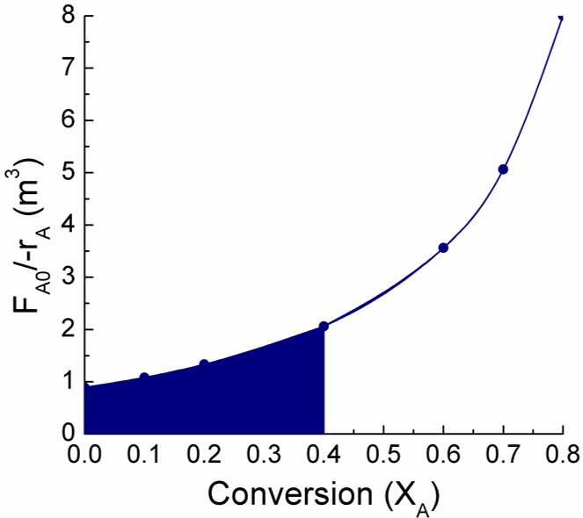
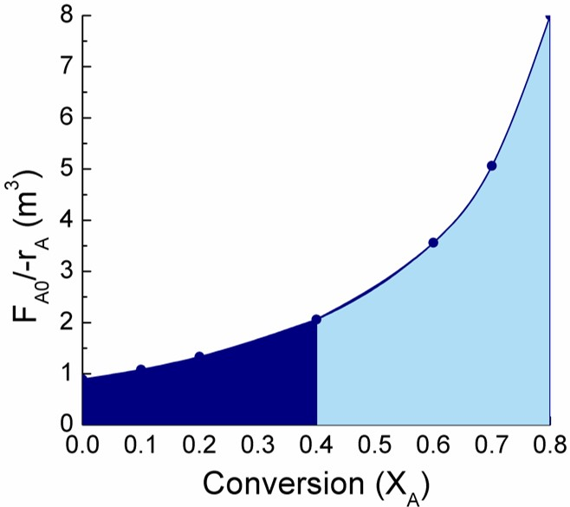
2 PFRs in Series
F_{A1} X₁
F_{A0}, X₀
F_{A2}, X₂
X_{A} | 0 | 0.2 | 0.4 | 0.6 | 0.8
F_{A0}/-r_{A} | 0.89 | 1.33 | 2.05 | 3.56 | 8
2 PFRs in series, X₁=0.4 and X₂=0.8
When X_{A1}= 0.4, V_{PFR1} =0.55 m³ (slide L3-20)
V_{PFR2} for X_{A2} = 0.4 to 0.8?
Same volume as 1 PFR with X_{A}=0.8

Slide 27
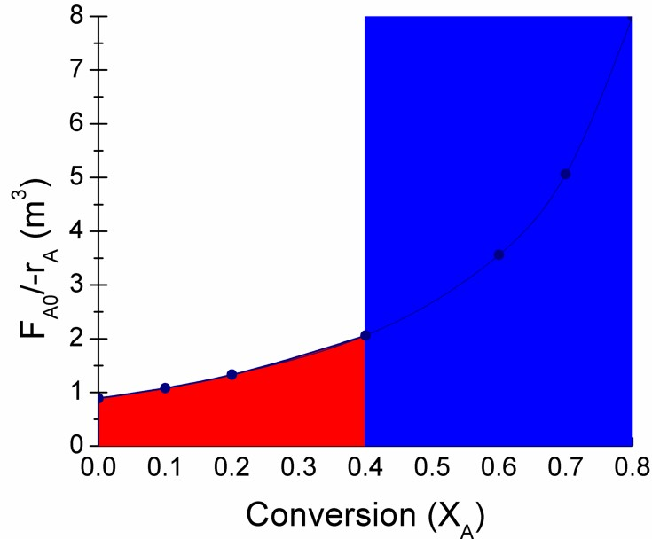
Combinations of CSTRs & PFRs in Series
F_{A1} X₁
F_{A2}, X₂
F_{A1}, X₁
F_{A2}, X₂
F_{A0}, X₀
F_{A0} X₀
V₁
V₂
V₂
V₁
V_{CSTR1}
V_{PFR2}
V_{PFR1}
V_{CSTR2}
( )
V_{CSTR1} ₊ V_{PFR2} ≠ V_{PFR1} + C_{CSTR2}

Slide 28
Reactors in Series
for any combination of PFRs & CSTRs in series
In general, 1 PFR = any number of PFRs in series
1 PFR = ∞ number of CSTRs in series
Definitions:
Space time (τ): time necessary to process one reactor volume, also called mean residence time or holding time
Space velocity (SV): inverse of space time, but v_{o} may be measured under different conditions than the space time
Liquid-hourly space velocity
Gas-hourly space velocity
υ₀| is the volumetric flow rate measured at specified condition

